Slide 1


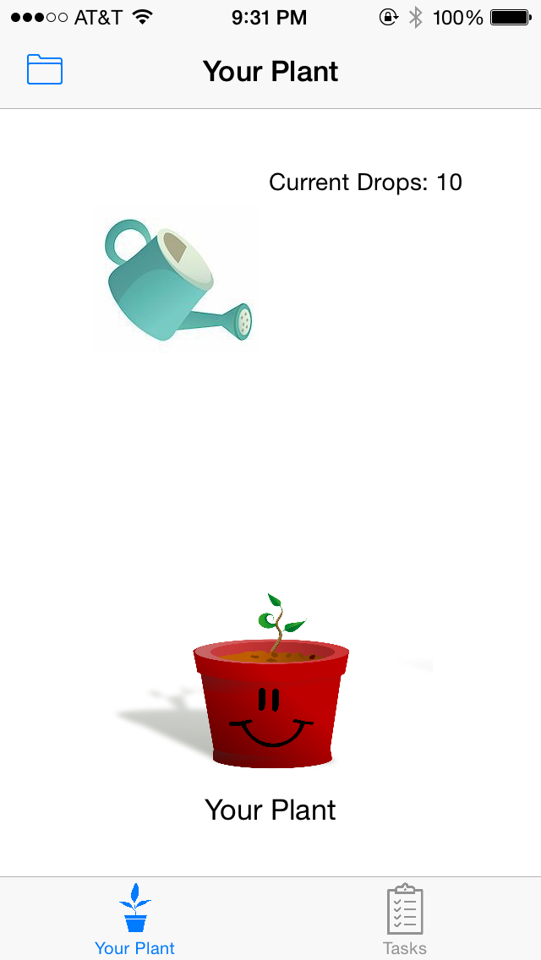
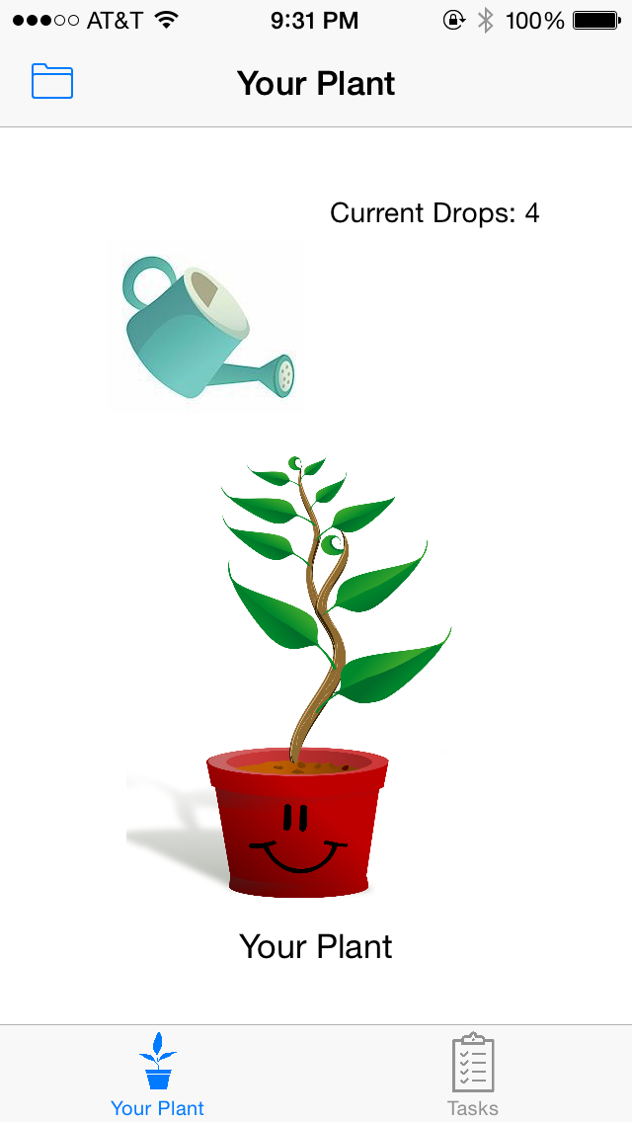
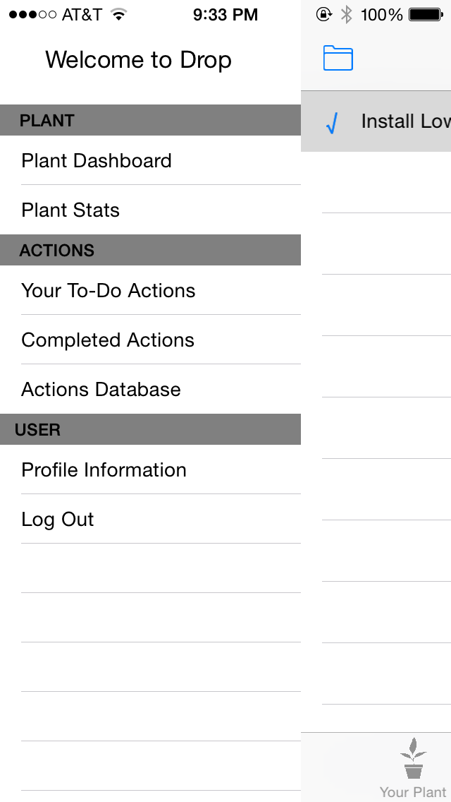
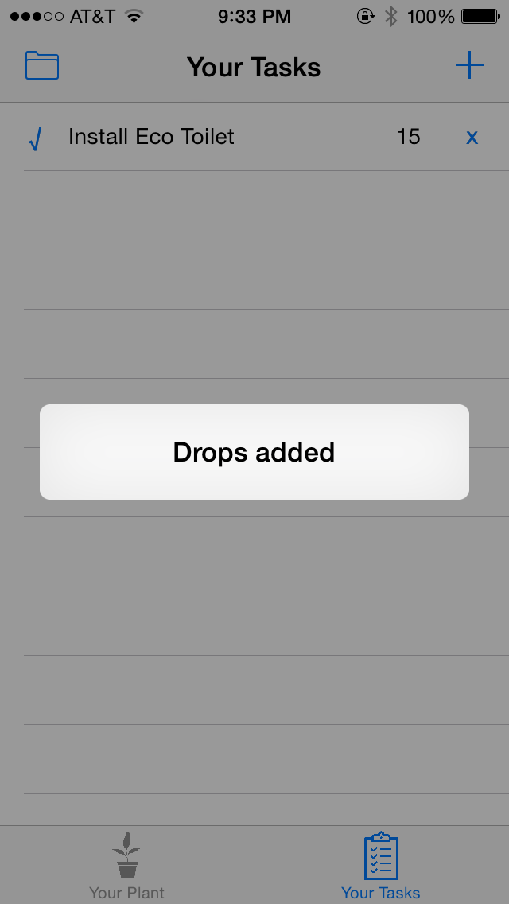
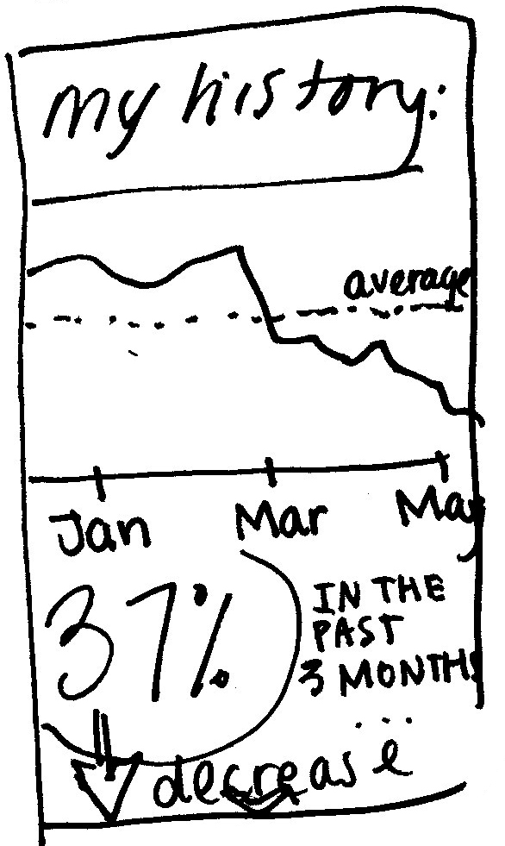
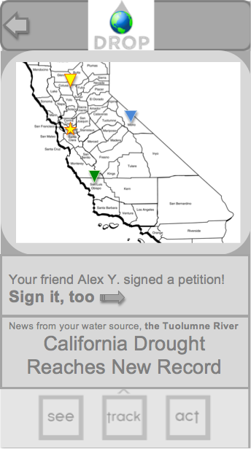
presenting
drop
Kelsey Josund, Megan Lu, and Matt Rolfo
”California wheezed its way into the fourth year of the worst drought in centuries.”
-New York Times, earlier this week
”Reducing water use sounds like work. Boring work.” – Secret voice inside your brain, right now
so we made it fun!
play a game
save water to grow your plants
save the earth
\
get rewarded for saving water
original low-fidelity concept
personal resource use aggregator
early-stage prototypes
revised medium-fidelity concept
social resource newsfeed
http://stanford.edu/class/cs147/projects/behavior/drop/
CS 147
Autumn 2014

